Slide 1
Linear Regression

Slide 2
• Linear regression is a statistical regression method which is used for predictive analysis.
• It is one of the very simple and easy algorithms which works on regression and shows the relationship between the continuous variables.
• It is used for solving the regression problem in machine learning.
• Linear regression shows the linear relationship between the independent variable (X-axis) and the dependent variable (Y-axis), hence called linear regression.
• If there is only one input variable (x), then such linear regression is called simple linear regression. And if there is more than one input variable, then such linear regression is called multiple linear regression.

Slide 3
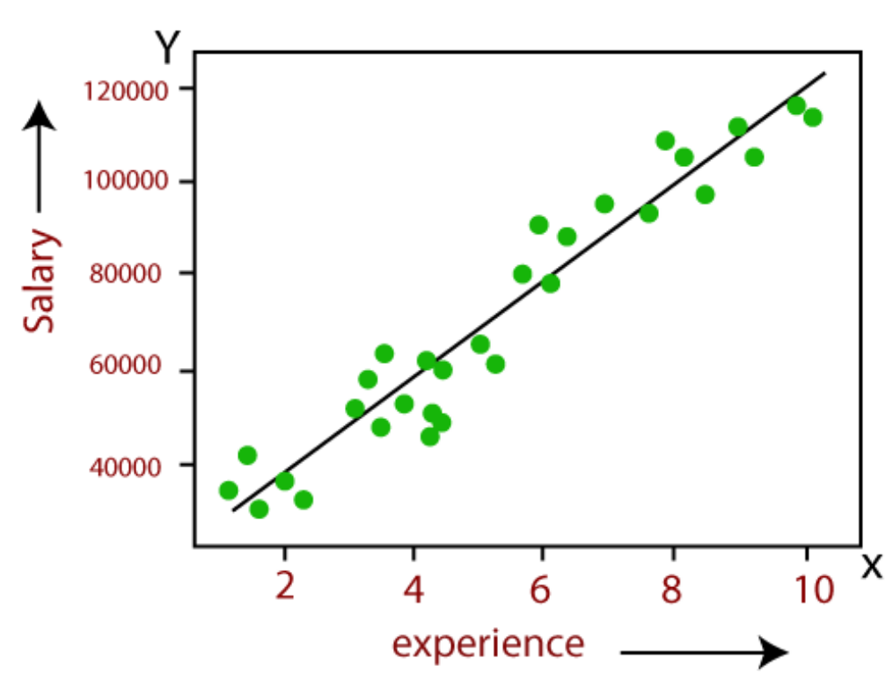
The given image explains the relationship between variables in the linear regression model. We are predicting the salary of an employee based on the year of experience.
• Below is the mathematical equation for Linear regression:
Y = aX + b
• Y = dependent variables (target variables),
• X= Independent variables (predictor variables),
• a and b are the linear coefficients

Slide 4
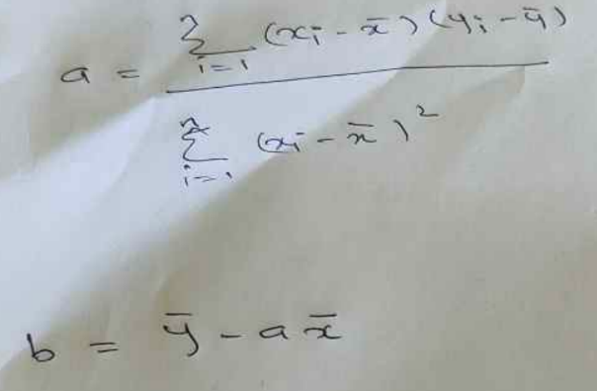

Slide 5
House Size in squareft(X) | House Price in dollars(Y)
800 | 100
1000 | 180
1200 | 230
1500 | 250
1800 | 340

Slide 6
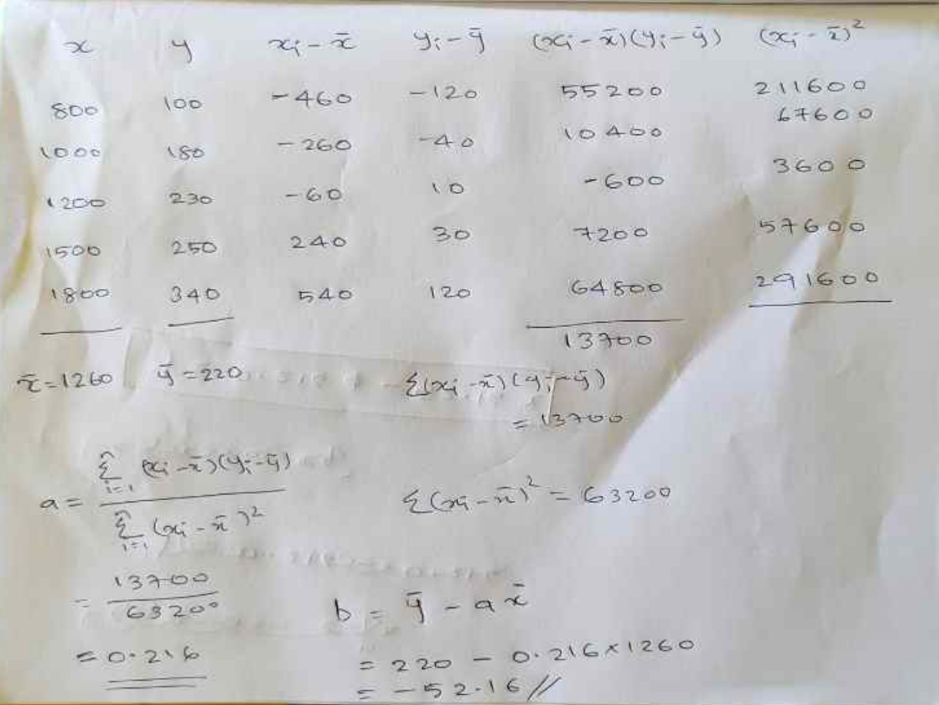

Slide 7
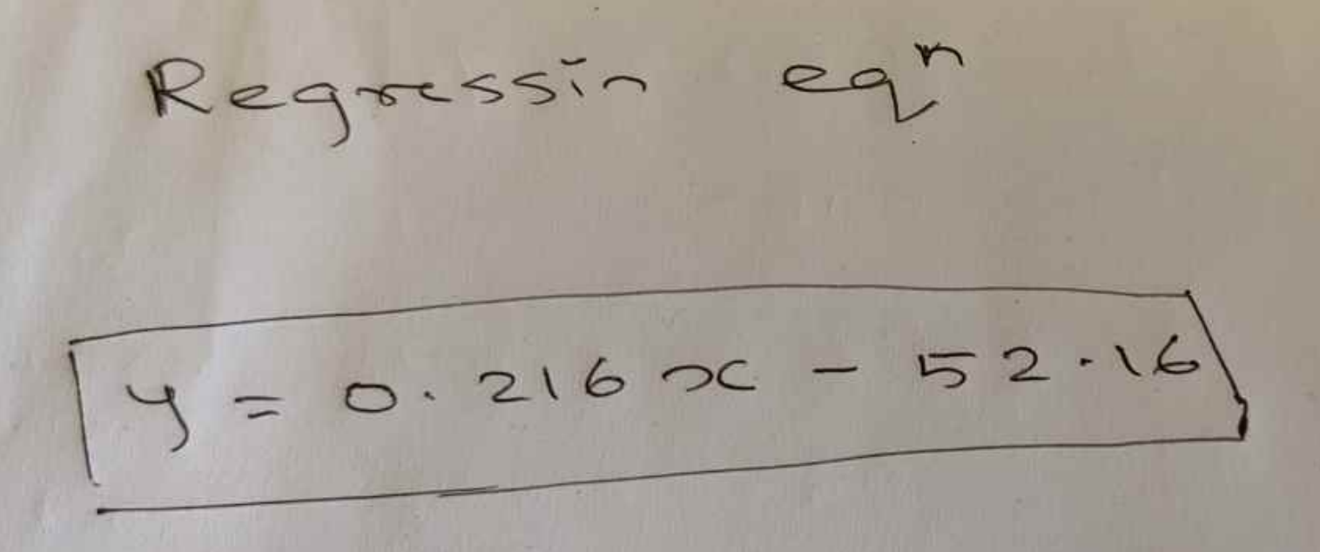

Slide 8
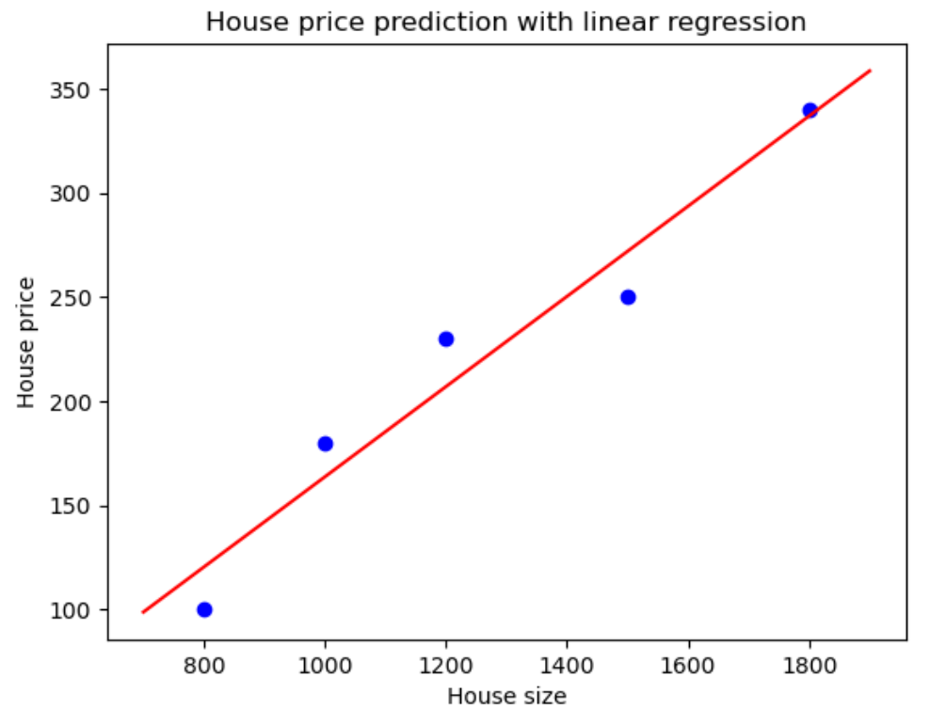

Slide 9
Applications of linear regression
Economic Growth : Used to determine the economic growth of a country or a state in the coming quarter , can also be used to predict the GDP of country
Product Price : Can be used to predict what would be the price of a product in the future
Housing sales : To estimate the number of houses a builder would sell and at what price in the coming months
Score prediction : To predict the number of runs a player would score in the coming matches based on previous performance

Slide 10
